Slide 1

Introduction to LightBurn software
Instructor: Whoever
Version 2021-05-01

Slide 2
What is LightBurn?
LightBurn is the software ETA uses to control our new lasers.
IMPORT shapes and arrange them. Some shape creation (lines or images) can be done in LightBurn, but this is best program that can export lines and images. *
CREATE you laser plan.
Set cutting/engraving speed and power parameters.
Determine order of cutting/engraving objects.
ALIGN your design and your material in the laser.
CHECK you cut using Frame
START your cutting/engraving job.
* LightBurn can import the following:
Image files: .bpm, .jpg, .jpeg, .png, .gif, .tif, .tiff, .tga
Vector Files: .ai, .pdf, .sc, dxf, .hpgl, .plt, .rd, .scpro, .svg, .lmrn

Slide 3
Q&A
Q: Why LightBurn/ what happened to RetinaEngrave
A: LightBurn enables you to access the full features available in the controllers of our new lasers. It’s better than RetinaEngrave and easier to use.
Q: Can I run LightBurn on my own computer?
A: Yes, but you’ll need to buy a license to use it for more than 30 days. One license can be used on up to two computers.
Q: Do I need to do all my project work on the computers conenctd to the lasers?
A: No, LightBurn is also available on the workstations in the ETA studio. It’s best to prep there to give osthers access to the lasers.
Q: Can I still use Inkscape?
A: Yes, but you’ll need to export your project and import into LightBurn to get it onto the laser.

Slide 4
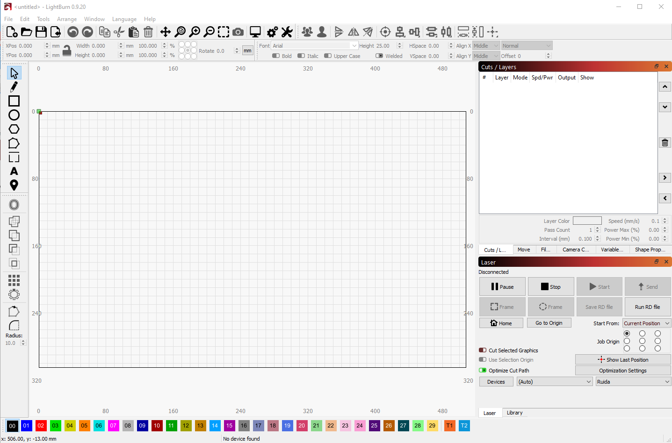
The LightBurn Screen

Slide 5
LightBurn
Main Menu
Settings
Mirror
Undo / Redo
Group
Align and adjust
File
Cut/ Paste
View
Preview
Numeric Edits
Text
Create shapes
Control window
Cuts / Layers
Move (the laser)
Camera Control
Variable Text
Shape Properties
Manipulate
Design Area – It’s the size of the cut area on the machine
Laser Control
Cut Palette - for Layer Assignment

Slide 6
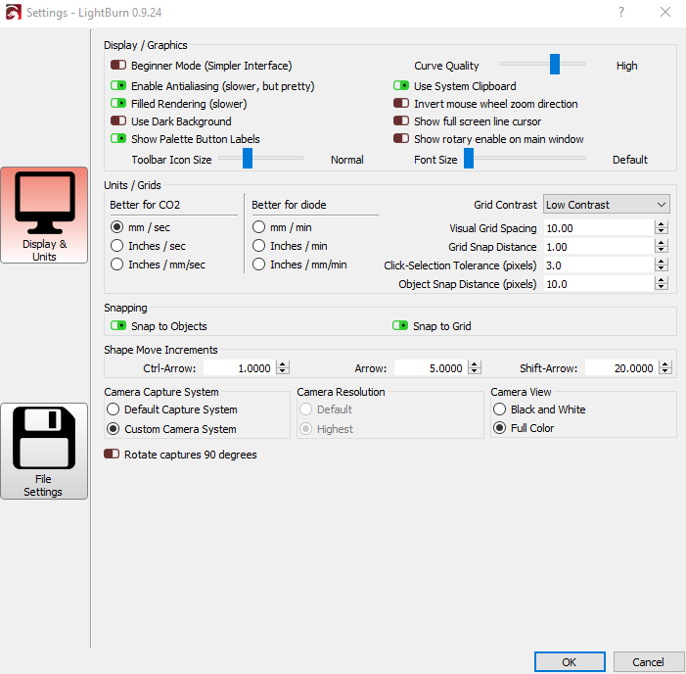
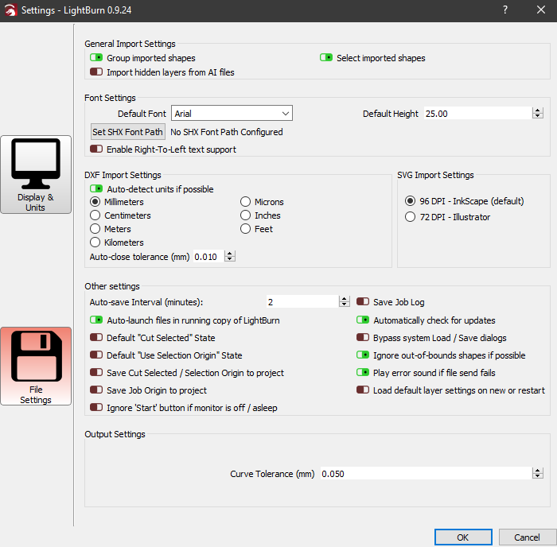
Some user settings to know
Click Edit, then select “Settings” to open the Settings window. There are two sections, Display and Units, and File Settings.
Group shapes on Import
Switch the zoom on the mouse wheel if it seems backwards to you.
Change the units if a DXF is coming in at the wrong scale.
Change the DPI if an SVG is coming in at the wrong scale.

Slide 7



Typical Laser Workflow
Create your design on the SW of your choice
Start LightBurn and select Device
Import your design into LightBurn
Set up the Cutting/Engraving parameters
VECTOR
IMAGE
Set power and speed
Set order of cuts
Preview your job
Group objects for Engraving or cutting
Edit Shape properties to adjust
Set power and speed
AT THE LASER
Adjust laser focus
Little Blue – turn knob
Big Red – monitor assist
Position the material on the cutting grid
Verify parts fit
Close lid, start, and watch
Always monitor the laser, while it’s running
Set power and speed

Slide 8
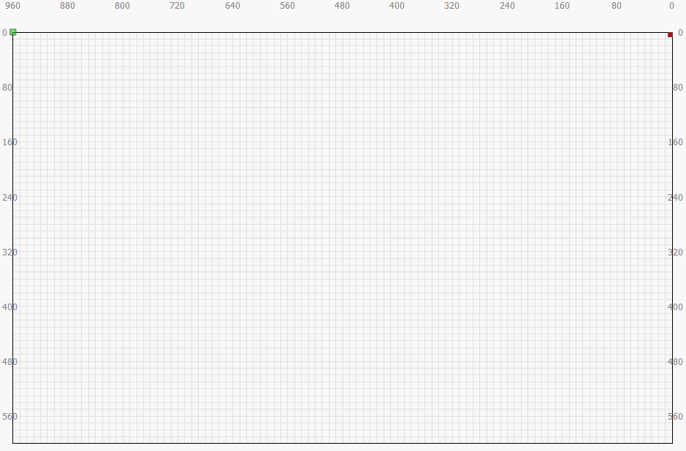
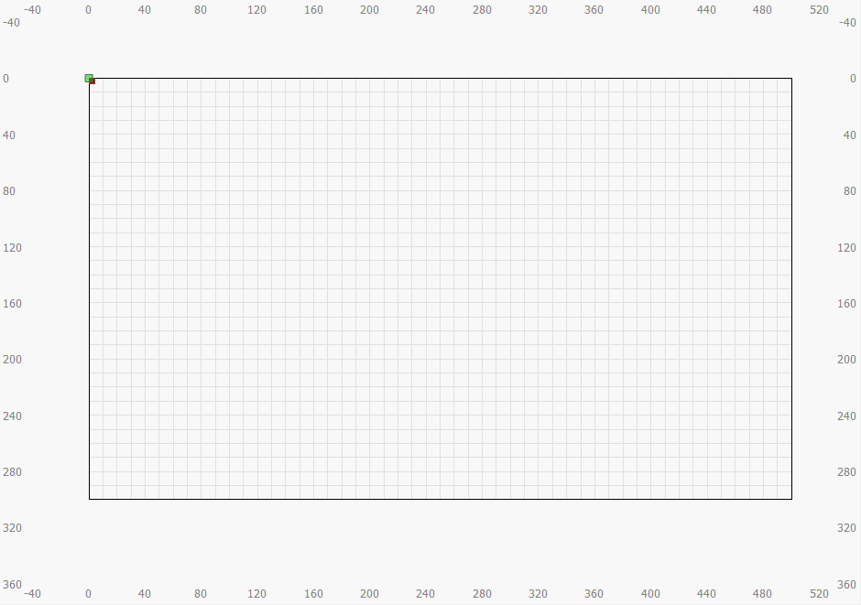
The Design Area
When you start the LightBurn app, it will find the laser connected to it and import parameters associated with it. The important parameters are the size of the design area, and where the origin is (which sets the direction of X and Y).
X increases from right to left
X increases from left to right
The origin is the top-right corner (little red square).
The origin is the top-left corner (little red square).
Design area
960mm wide
600mm tall
Y increases from top to bottom
Design area
500mm wide
300mm tall
Y increases from top to bottom
Big Red
Little Blue

Slide 9
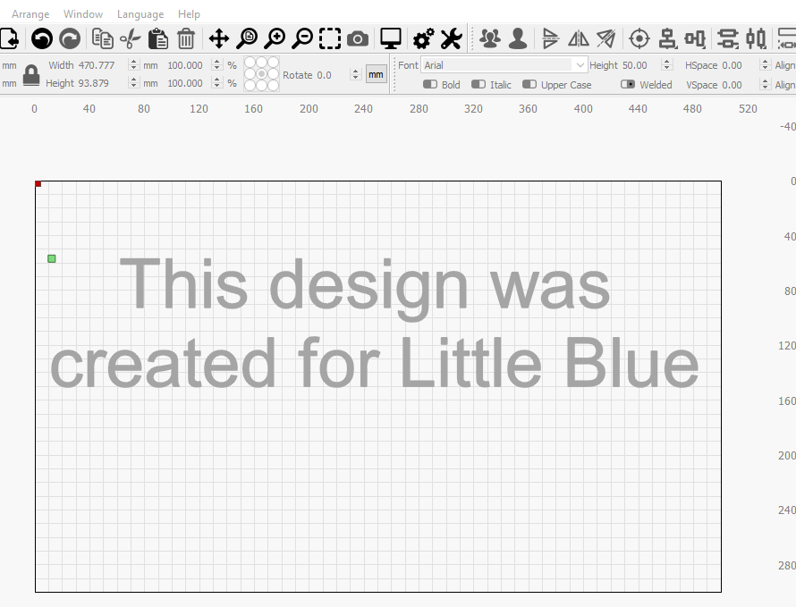
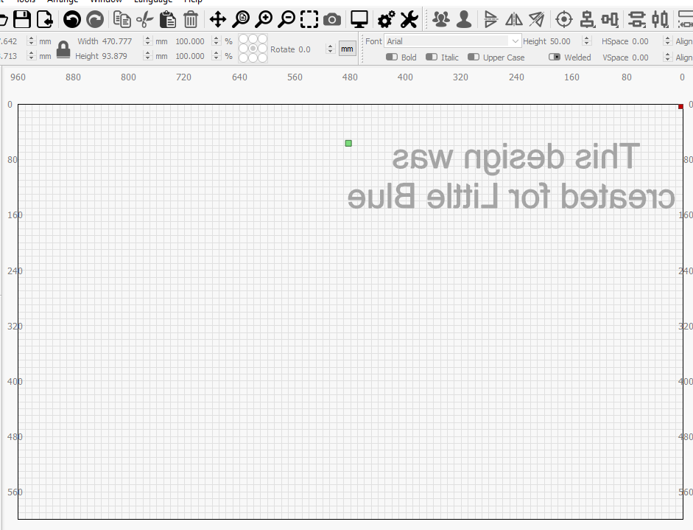
Switching Machines
If you save your design on one machine and then open it on the other, the different directions of the Y axis will cause the design to be mirrored. The fix? Make sure Show is ON for all layers, select all objects and do a horizontal mirror
Horizontal mirror
Little Blue
Big Red

Slide 10
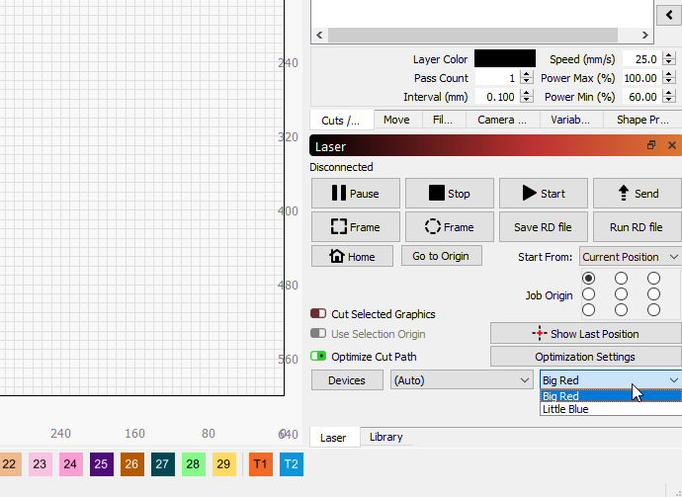
Using the Studio workstations
If you are using a workstation in the main studio (or a personal copy of LightBurn), you should select the device (Little Blue or Big Red) that you plan to use when you go to the laser. Look in the bottom right corner of the Laser window and there is a dropdown with all the devices this copy of LightBurn has set up.
The Laser Window has a drop down for Devices. Pick the one you plan to use.

Slide 11
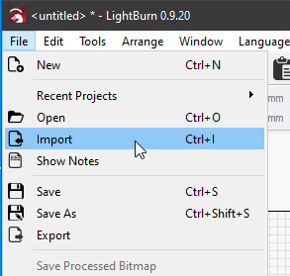
Import your design
1. File Menu
2. Import
3. Select your file
OR
Drag and drop you file onto the design area.

Slide 12
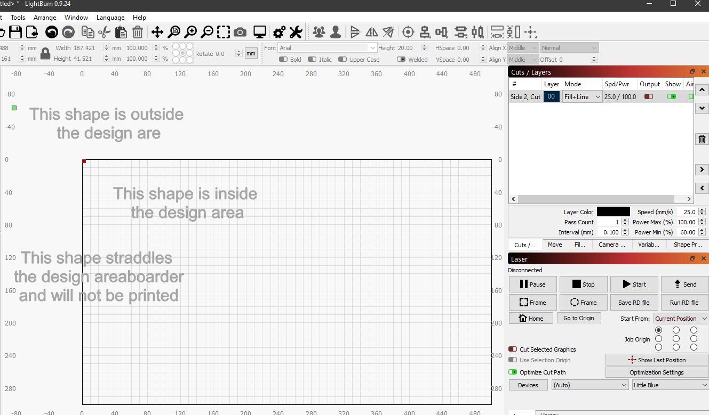
Positioning your design
When you start the LightBurn app, it will find the laser connected to it and import parameters associated with it. The important parameters are the size of the design area, and where the origin is (which sets the direction of X and Y).
Objects outside the design area may not be cut, but can drive where the laser tries to start from (green square), even if Output is OFF.
Best to keep all objects inside the design area to avoid unexpected behavior
Objects that straddle the design area will not be “partially cut”
X increases from right to left
X increases from left to right
The origin is the top-right corner (little red square).
The origin is the top-left corner (little red square).
Design area
960mm wide
600mm tall
Y increases from top to bottom
Design area
500mm wide
300mm tall
Y increases from top to bottom
Big Red
Little Blue

Slide 13
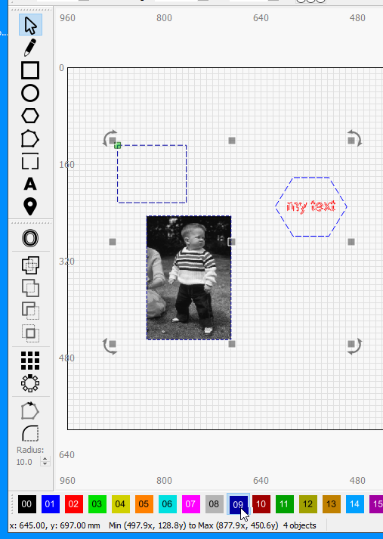
Assigning objects to layers
Select one or more objects that you want to use the same cutting parameters on.
Select a Layer (your choice) from the “Layer Palette” and the lines of the objects will change to that color
Be sure to use object select and move mode
Selecting multiple objects
Boxing from the left only selects shapes fully enclosed
Boxing from right selects all shapes with any bit in the box

Slide 14
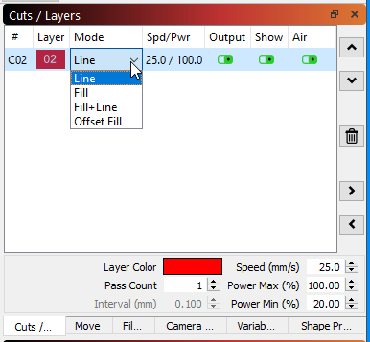
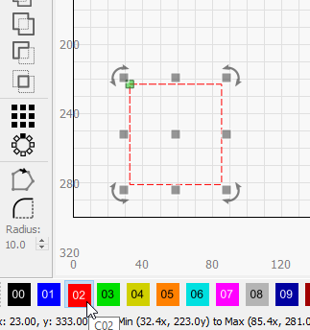
Setting Cut parameters
Each object needs to be assigned to a “Layer”. The “Cut Parameters” control what the laser does with each object. The order of the layers can (usually does) control the order the objects are cut/etched.
Lase objects on this layer?
First, select an object, then select a layer from the bottom row. The color does not matter.
Select a “MODE”
Line – follow vectors
Fill – raster fill the object, but no outlines
Fill + Line – do both
Offset fill – spiral fill (vs raster)
Show object on this layer in the design area?
Speed – speed of laser
Power Max - “normal” power
Power Min - minimum power when the laser slows down at a corner.
How many times to repeat this layer
If the window is hidden, click on it’s tab

Slide 15
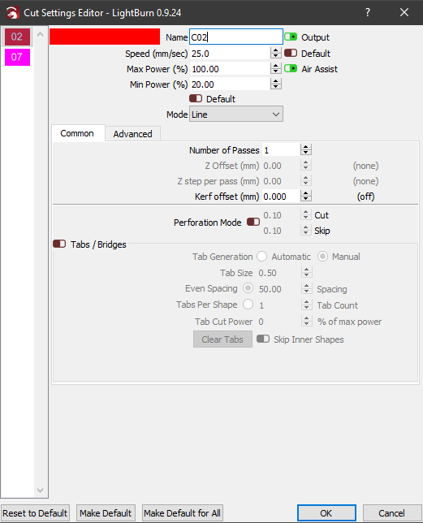
More Cut parameters
Double clicking on a layer in the Cuts/Layers window opens the full set of cut parameters. We’ll only talk about a few here.
Naming your layers helps you keep track of things in your design .
Speed/Power/Mode settings
Offset the cut to account for the laser kerf
Make a dashed cut or etch line.
Please don’t reset the defaults

Slide 16
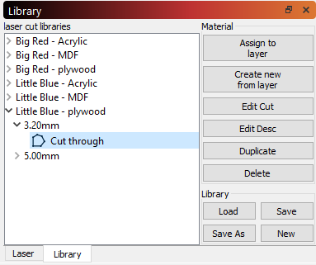
What cut settings to use?
We have created a library of cut settings for typical materials. These can be assigned to a layer. It’s a great starting point.
3. Expand material, thickness, and select a named cut
Important – pick for the machine you plan to use
1. Select a layer you want to assign library cut parameters to
4. Click “Assign to Layer” to copy the cut parameters to your current layer
2. Select the Library tab if the library window is not visible. Normally the laser tab is visible.
You can save a copy of the studio library to use at home.
After assigning a library cut to your layer, you can modify the cut settings for that layer without affecting the library. - it’s a copy operation, not a linking operation.

Slide 17
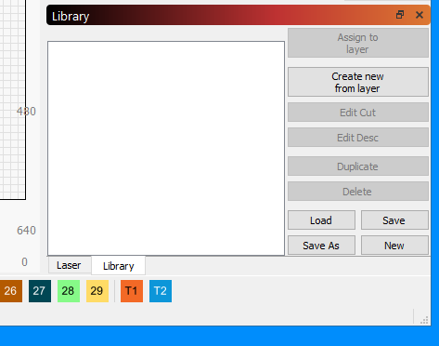
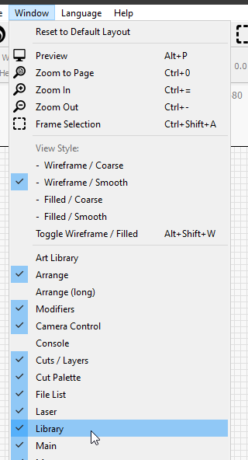
Select material
If the Library tab or window is not visible, turn it on from the Window menu
Select the Library tab, then …

Slide 18
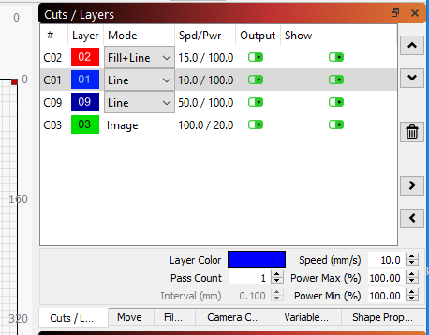
Set Power and speed
Select a layer.
Select the mode – Applies to all shapes on the layer. LB will select “Image” for image shapes.
Select the cutting speed and power. Consult BARN recommendations, use the material library, or make your own test cuts. The min power is the lowest it will go to as it slows down at corners. If you get burned corners, reduce this.
Select the number of passes the laser will make.
If the Cuts/Layers tab or window is not visible, turn it on from the Window menu

Slide 19
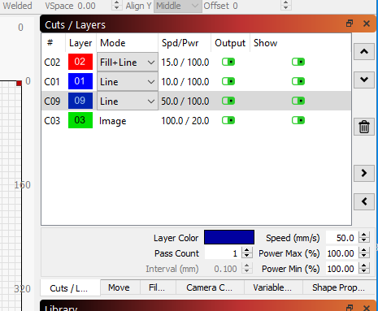
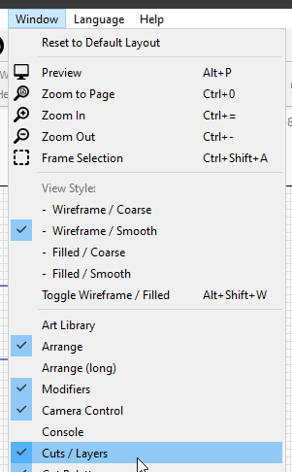
Cutting order... Too many ways Most used – Cuts/Layers
Most common - priority by layer order
Move a layer up or down in priority with these arrow buttons
Turning off “Output” means it wont’s be cut
If the cuts/Layers tab or window is not visible, turn it on from the Window menu

Slide 20
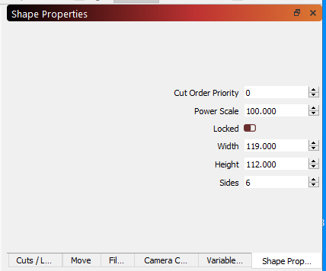
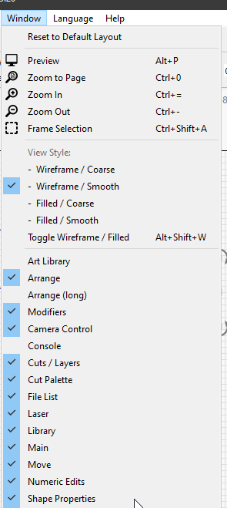
Cutting order... Too many ways Shape Properties
Usually used to set priority of shapes within a single layer
Give a Cut priority here.
You can also scale the layers power setting for each shape
menu items in this window change based on the shape selected.
If the Shape Properties tab or window is not visible, turn it on from the Window menu

Slide 21
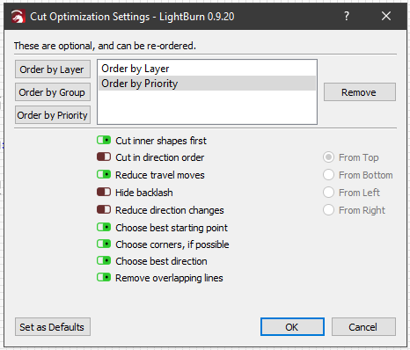
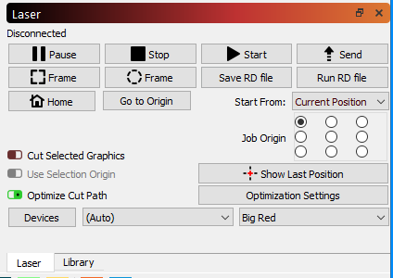
Cutting order... Too many ways Optimization Settings
We recommend these settings
Layers first, then priority within Layers
Cutting inner shapes first is good.
Let LightBurn not cut multiple times when shapes share edges.
LightBurn will select an optimized cut order if it can. This window sets it.
LightBurn optimization can be turned off. We like it left on.

Slide 22
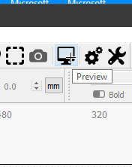
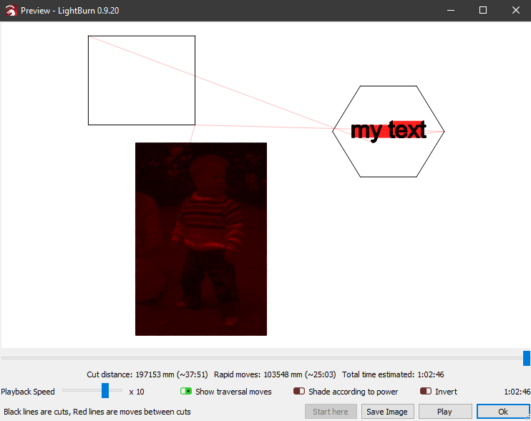
Preview your cutting
Select the Preview icon on the tool bar, or right click on the design space and select Preview.
The preview window will show you the order of cuts, and the total cutting time.

Slide 23
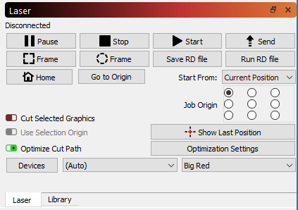
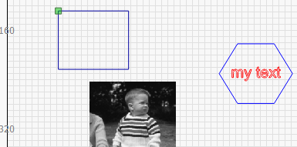
Place your material on the bed
You need to tell LightBurn where to start cutting from This is done in the Laser window.
We recommend moving the laser to the back left corner of the material, and the following settings
Start from “Current position” (the place where you just positioned the laser).
Then select the “Job Origin”” to match which corner of the material you moved the laser to.
LightBurn will put a little green square on the design to show where the laser will start.
The Next step (Frame) will tell you if you got everything right.

Slide 24
“Focus” the laser
Place your material on the cutting grid so that it is under the laser cutting head (you might need to move the laser over the top of your material – use the buttons on the laser control panel – you can’t grab the laser and move it like on the old FS laser.
BIG RED
This laser “autofocuses” by moving the material bed up and down. We are still developing procedures that will be sure the laser doesn’t accidentally crash into itself while moving the bed.
SO… Ask a monitor to help you with the focusing step on Big Red.
LITTLE BLUE
This laser focus is adjusted by moving the med up and down (not fussing with the lens like the old FS laser). There is a knob inside the laser – front right corner – that moves the bed up and down.
Move the bed down so your material can be placed under the nozzle.
Move the bed up until the nozzle is 6mm from the surface of your material. There is a piece is 6mm plywood to use as a gauge. The setting in not too fussy. You can see when the nozzle just about touches.

Slide 25

Frame
When you click one of the two frame buttons, the laser will move around the outside of the area where the cuts will take place. If the laser traces off your material, something needs to be changed.
The laser traces a rectangle that encloses all the cuts to be made.
The laser traces a “rubber band line” around the shapes it will cut.

Slide 26
Vector Graphics vs Images
VECTOR GRAPHICS:
Definition: Points, lines, curves defined by math.
If you keep zooming in, the lines stay sharp.
Why do we care?
We can enlarge or shrink vector images and not lose image quality.
The laser can be easily guided along these lines to cut through the material.
There are lots of programs that let us create designs we save as vector format.
IMAGES (Raster graphics):
Definition: A group dots (pixels), each with a color , that make up an image.
If you keep zooming in, you eventually see the dots.
Why do we care?
We can burn a picture of “Little Jimmy” on something we make.
Since the laser needs to travel to each pixel location, and fire an amount of energy based on the color of the pixel, it can take a long time to render an image.
We can cut through the material based on a raster image, but it’s tedious and impractical. Like cutting a piece of paper in hole with a hole punch.

Slide 27
Image workflows
There are generally two destinations people are pursuing when working with images:
1. Burn a realistic picture onto something.
2. Extract from the image to create something to cut/engrave.
Realistic pictures
Insert your picture.
Scale it up/down to fit your intended size.
Select the image, then Right click the image and select “Adjust Image” from the pop-up menu.
Select the “Image Mode” and adjust as desired. Click OK.
Modify speed/power in the Cuts/Layers menu.
This is a trial/error process. Expect to spend time finding your artistic muse.
Extracting from images
Insert your picture.
Select the image, then Right click the image and select “Trace Image” from the pop-up menu.
Adjust with the sliders until you like it. Click OK.
Move or delete the original image. If not deleted, set “Output” off in Cuts/Layers window.
Scale it up/down to fit your intended size.

Slide 28
Focus
Place your material on the cutting grid so that it is under the laser cutting head (you might need to move the laser over the top of your material – use the buttons on the laser control panel – you can’t grab the laser and move it like on the old FS laser.
BIG RED
This laser “autofocuses” by moving the material bed up and down. We are still developing procedures that will be sure the laser doesn’t accidentally crash into itself while moving the bed.
SO… Ask a monitor to help you with the focusing step on Big Red.
LITTLE BLUE
This laser focus is adjusted by moving the med up and down (not fussing with the lens like the old FS laser). There is a knob inside the laser – front right corner – that moves the bed up and down.
Move the bed down so your material can be placed under the nozzle.
Move the bed up until the nozzle is 6mm from the surface of your material. There is a piece is 6mm plywood to use as a gauge. The setting in not too fussy. You can see when the nozzle just about touches.

Slide 29
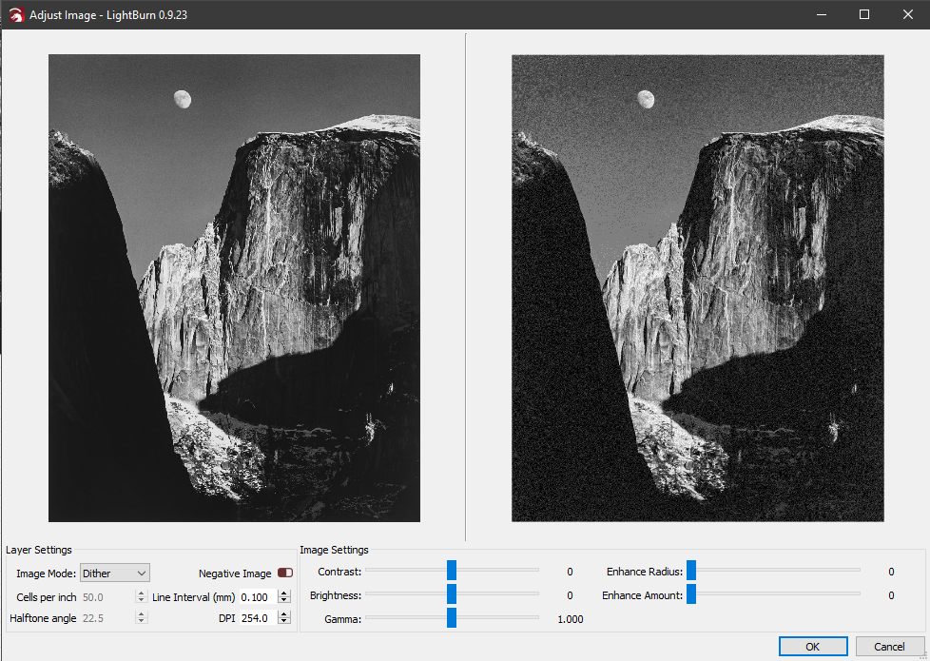
Image Adjust window
With Image Mode applied
Original Image
Slider bars adjust the original image before the mode filter is applied.
Select Image mode here

Slide 30
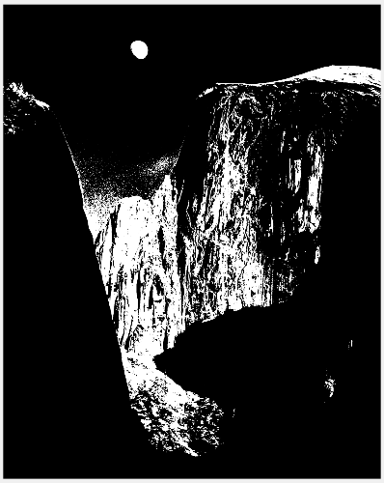
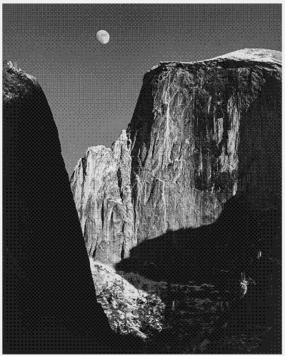
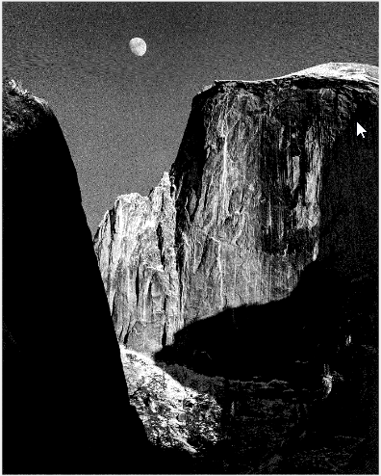
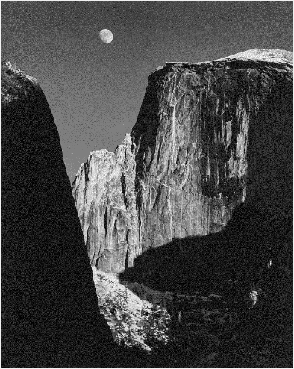

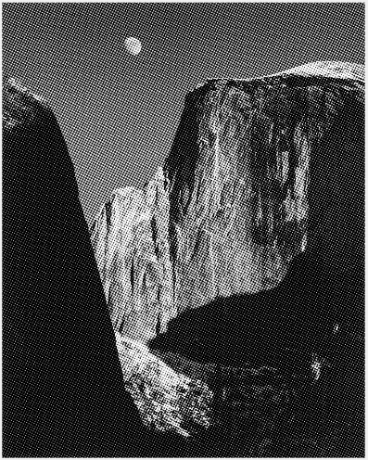
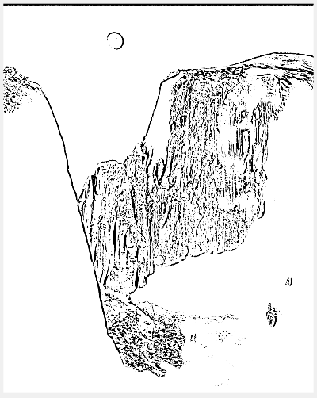

Image adjust filters
Threshold
Ordered
Atkinson
Dither
Newsprint
Halftone
Sketch
Grayscale

Slide 31
Photo Summary
Expect to spend some time practicing with pictures before getting one you this is “just right”. When you do get there, please share what you’ve learned, maybe teach a class on the subject.
Getting your picture “just right” will likely involve applying filters, and adjusting photo parameters. You can use the LightBurn tools, but you can also pre-process photos in a lot of other applications before you import them to LightBurn, and those apps may have better filters. Don’t be afraid to pre-process your photos.
Other good advice to be added here once we learn it.

Slide 32
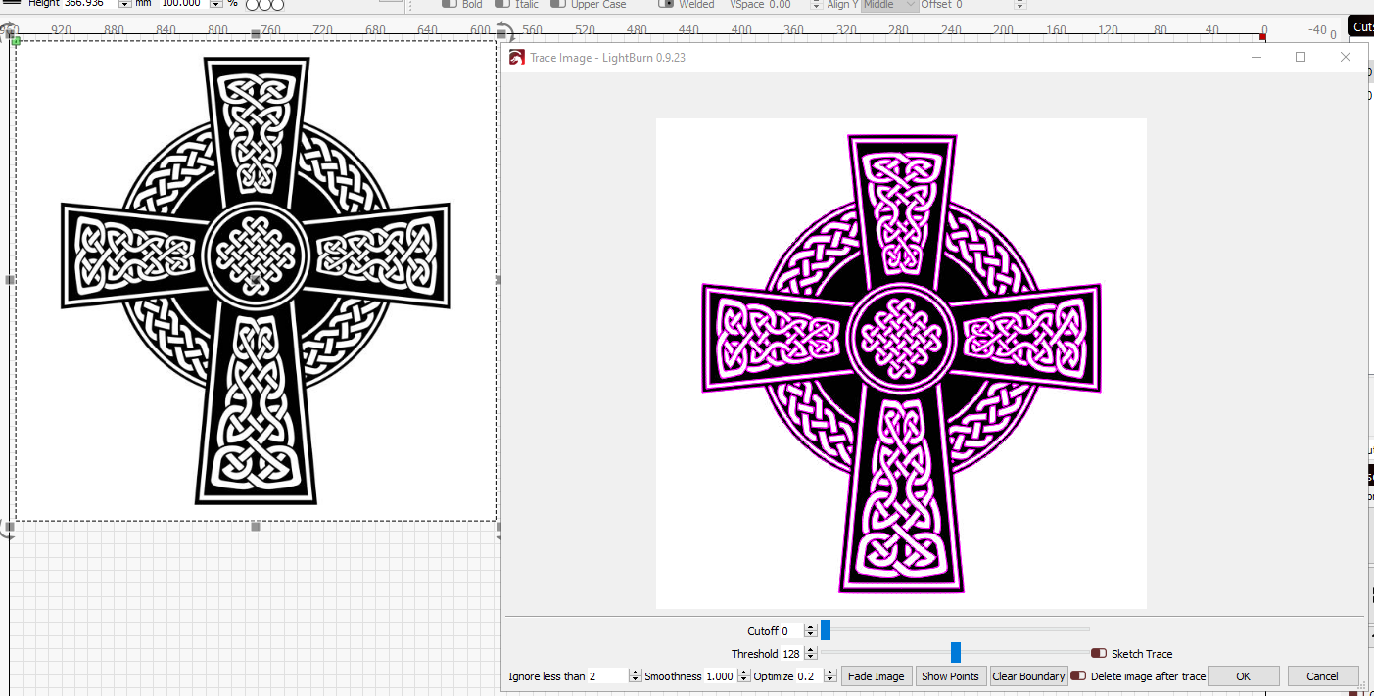
Converting Images to vectors
You can convert images into vectors - this works better with graphics than pictures. After importing your image, left click to select it, then right click and select “Trace Image” in the pop-up menu.
Slider bars adjust how LightBurn finds edges.
Original Image
The traced image is left on top of the original. Move or delete the original to see the vector image

Slide 33
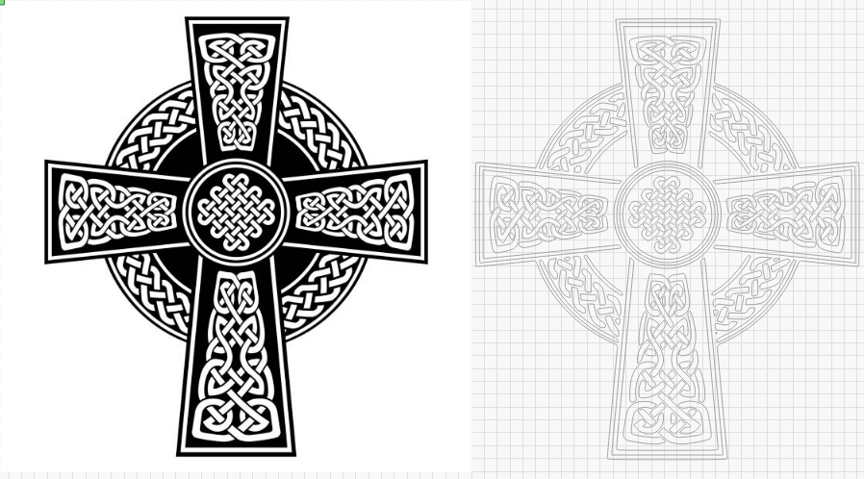
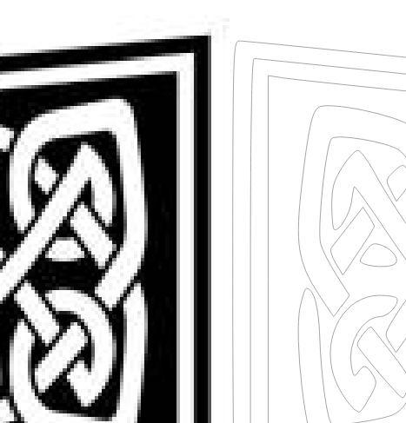
Converting Images to vectors
Original Image
Vector Image
Close up of original image and vector lines.

Slide 34
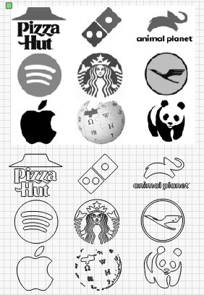
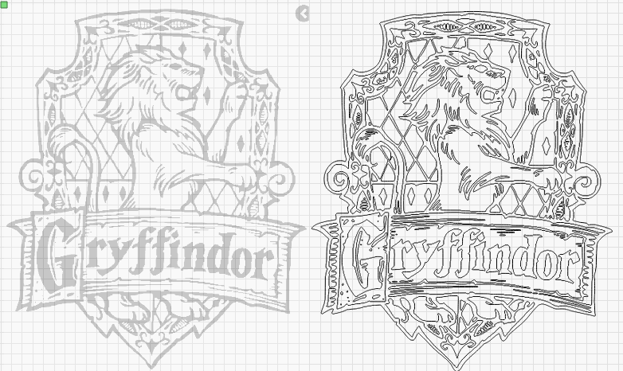
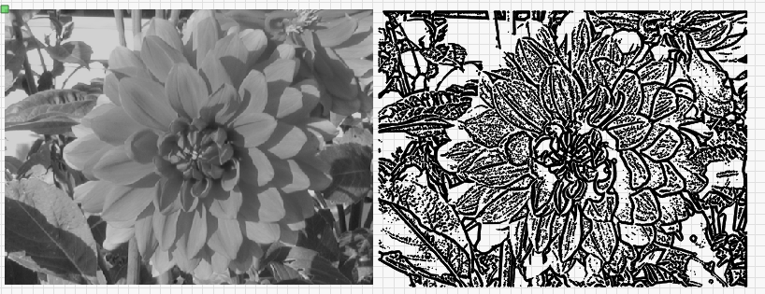
Other examples

Slide 35
Tips for working with imported shapes
Imported shapes that are more than just an outline (example, square with a hole in it) are imported as separate shapes. It’s important to group them all together if you want to move them easily.
Be careful when grabbing objects to move them. If you grab a corner or side handle, it’s easy to accidentally stretch or shrink a shape.
The “Numeric edits” window lets you set the sixe of objects, or rotate them a specific amount.
if you are cutting multiple parts on one piece of material, adding a rectangle the size of your raw material gives you a guide for packing them in. You can rotate and flip them to pack closer together.

Slide 36
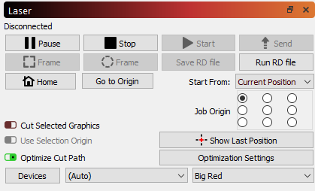
Downloading LightBurn
You can run LightBurn on your own computer. Go to https://lightburnsoftware.com/ and follow the “Download/Trial” link. The software is free for 30days.
Installation – When you first run LightBurn, it wants you to connect it to a Device.
Select “Create Manually”.
Scroll down and select “Ruida” from the controller list, then Select “Next”.
Select “Serial/USB”, then Select Next.
A. Name your printer “Little Blue”, or “Big Red” – or whatever you want. B. enter the X and Y dimensions (X = 500mm, Y = 300mm for little Blue; X = 1000mm, Y=600mm for Big Red). Then Select Next.
Select the button for Laser’s origin. “Rear Right” for Big Red, and “Rear Left” for Little Blue. Then Select Next.
Select Finish. You are ready to go.
You can add another device (or edit the one you created) by clicking on the “devices” button in the Laser window. If you have two or more devices, you can select which to use in this window.
Select “Devices” in the Laser window to add or edit a laser

